Slide 1
Applying for a Work Permit in Taiwan
For foreign students

Slide 2
Visit the webpage and create an account
Use the following link to access the website https://ezwp.wda.gov.tw/wcfonline/wSite/Control?function=IndexPage
Select “Work Permit for Foreign Students, Overseas Chinese Students and Ethnic Chinese Students”

Slide 3
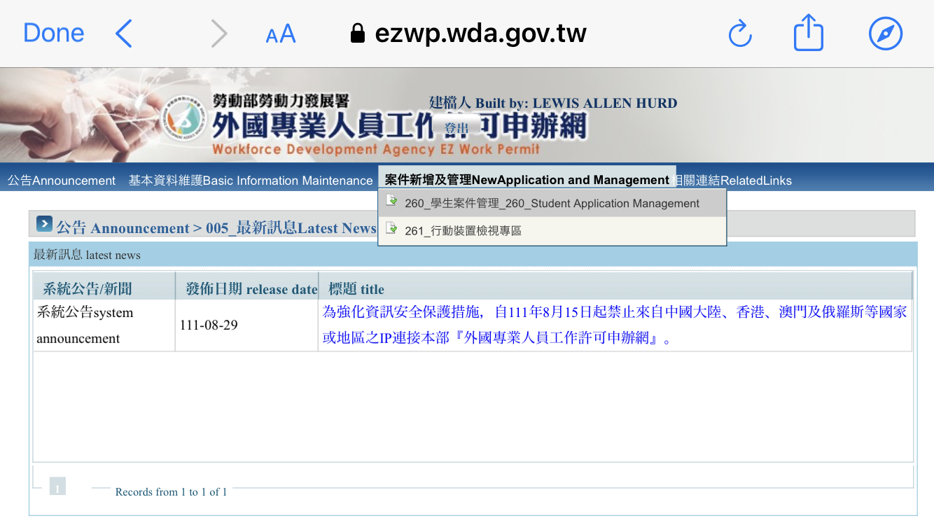
Start your application
Select “New Application and Management” then select “Student Application Management”

Slide 4
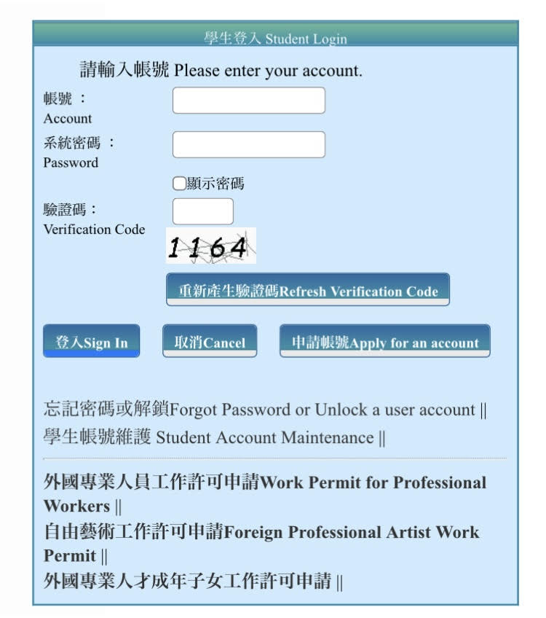
Step 1 – Personal information
Select “Apply for an account” and fill in your
personal information. Your ARC number can be used for
both your “account number” and the “UI number”

Slide 5
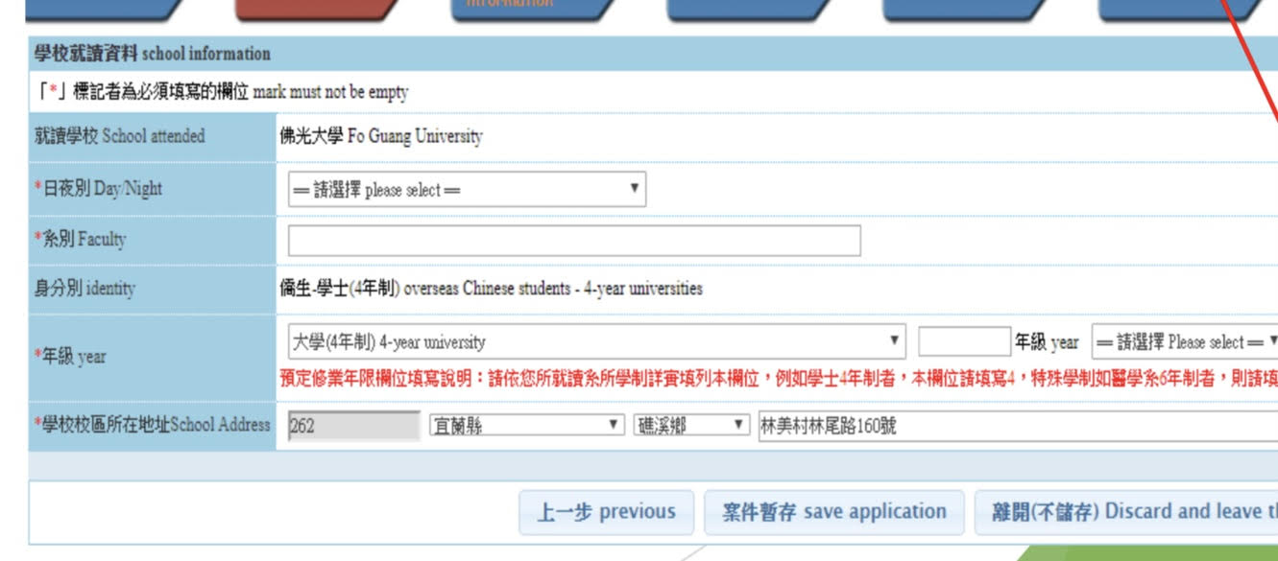
Step 2 – School Information
Enter your school information

Slide 6
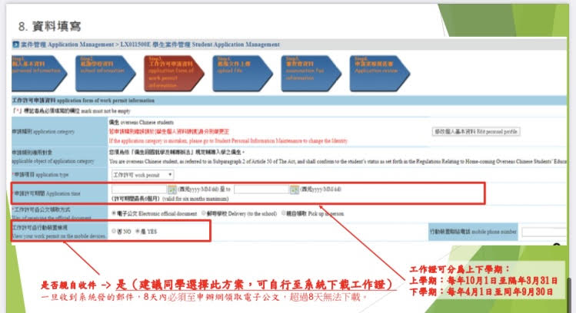
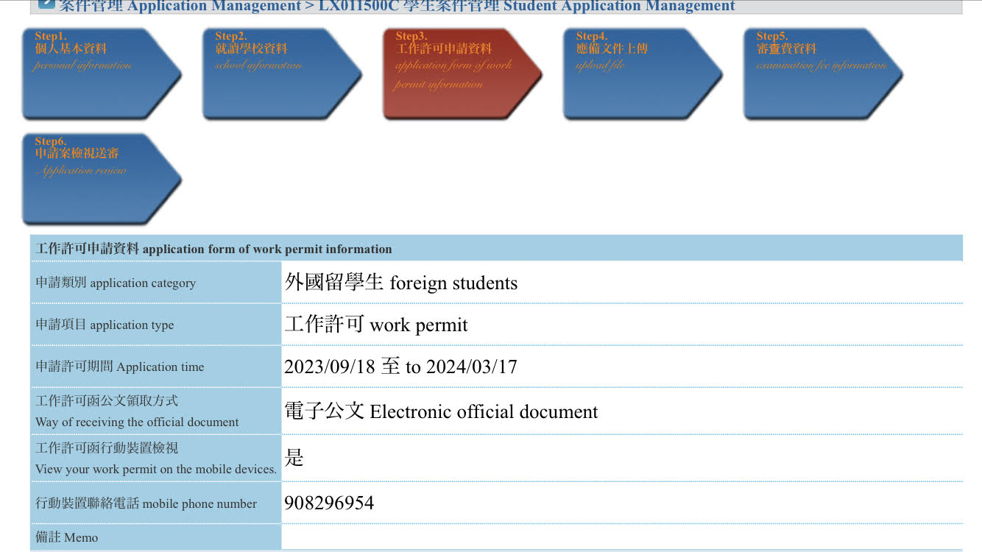
Step 3 – Application form of work permit information
Select application type etc. Choose to receive an electronic copy
No need to enter “886” as the first three digits of your Taiwanese phone number
Choose the electronic document

Slide 7
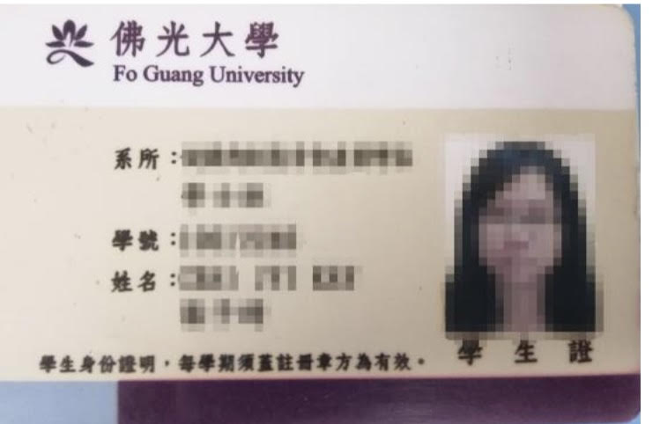
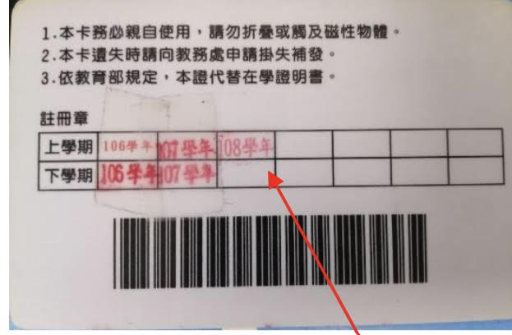
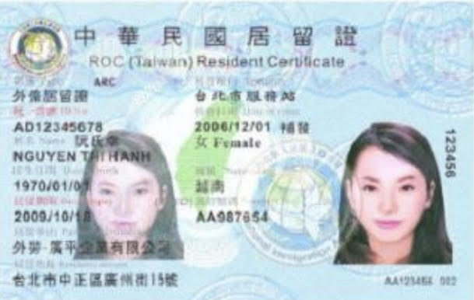
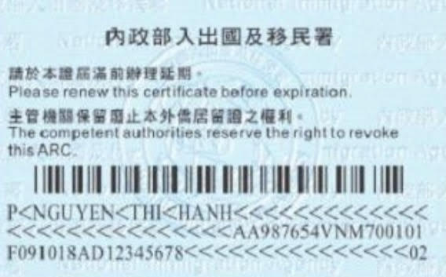
Step 4 – Upload files
You will need to upload a scan of your documents as PDF files. Be sure to get both front and back of both your ARC and student ID. You can submit more than one file to each category.
The back of your student ID must be up to date with its stamps

Slide 8
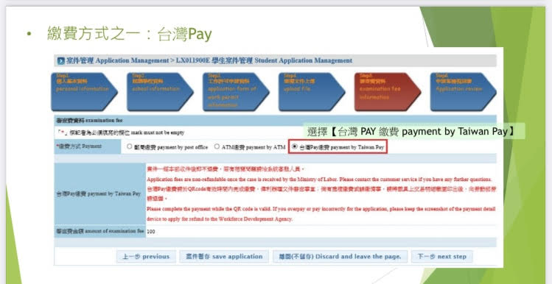
Step 5 – Examination Fee
You will need to pay a 100 NTD before your application can be reviewed. You can pay this fee in different ways, but it is recommended to simply use the school’s atm machine to transfer funds. Input the information given to make the transfer at the atm. If you are unfamiliar with this process, ask someone to help you.
After payment, do not forget to finally submit your application for review by the school. If any information or materials are incomplete, your application will be sent back to you for revision.

Slide 9
Step 6 – Application Review
You will receive an email once your application has been approved. The process could take up to two weeks but may be approved sooner.
Once you receive an electronic file, you must upload it to the school system.

